Slide 1
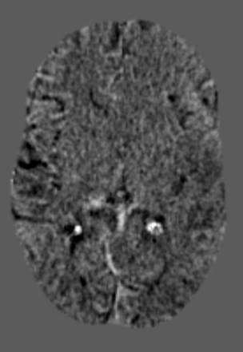
Problem: Sometimes Co-Pilot doesn’t make subtractions quickly or at all (seemingly on the busiest call nights) what to do??

Slide 2
Make your own!
4 steps
Once you get the hang of it, it is very fast to do

Slide 3
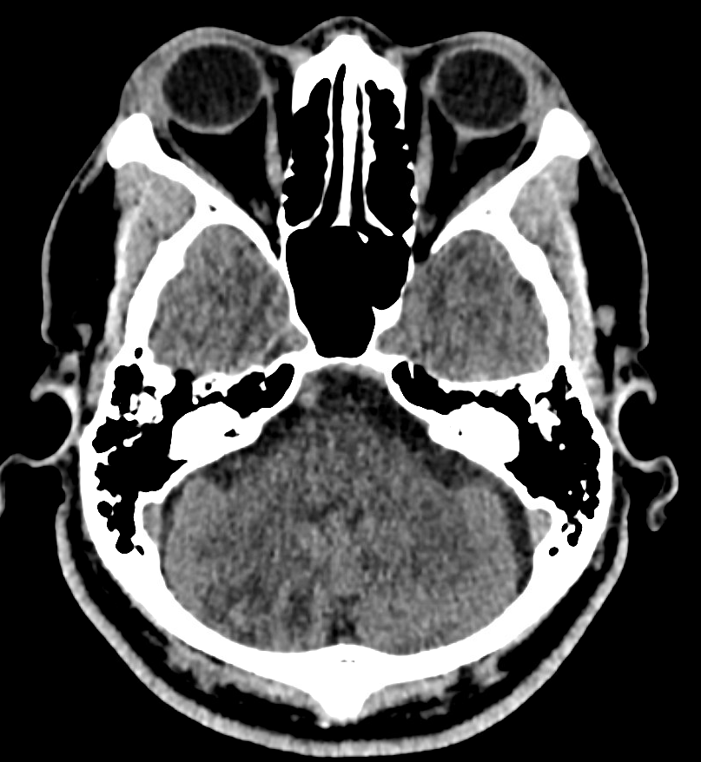
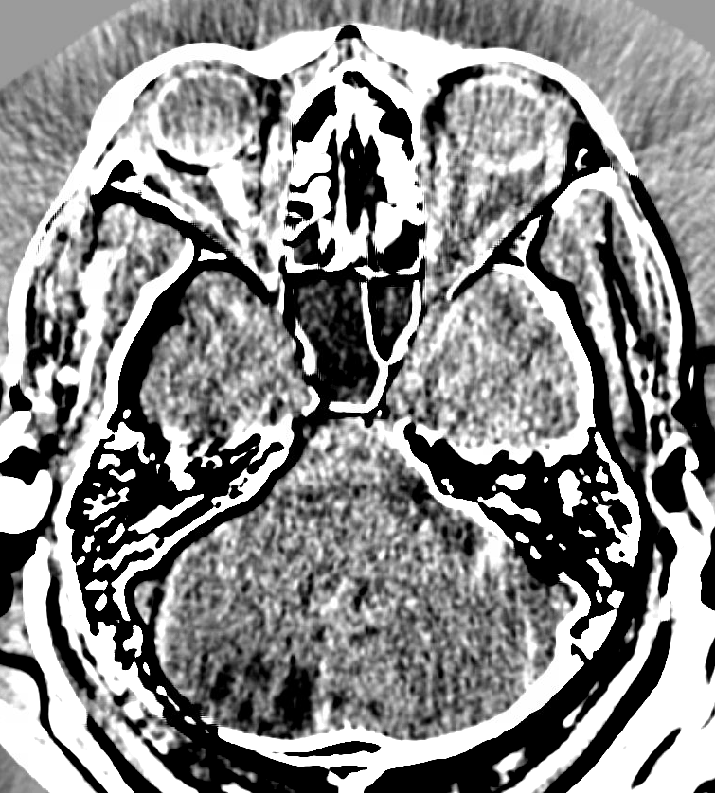
Example:
Original:
Custom subtraction:
CQI for new right cerebellar infarcts. Note how much more the hypoattenuation POPS OUT on the subtraction

Slide 4
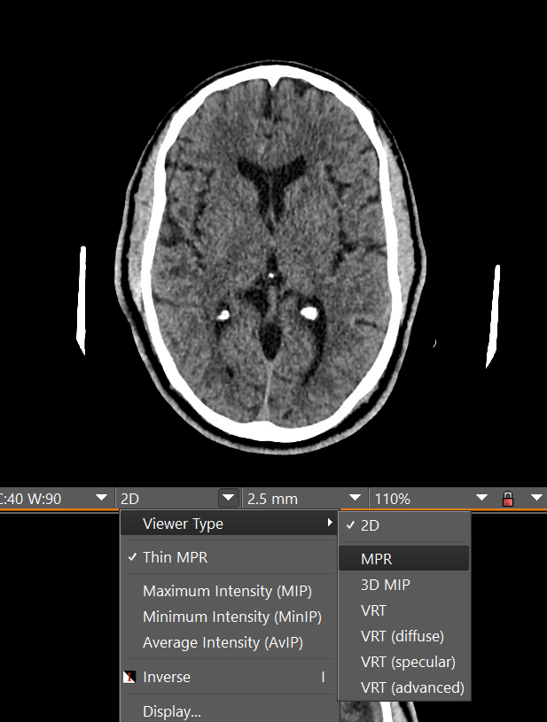
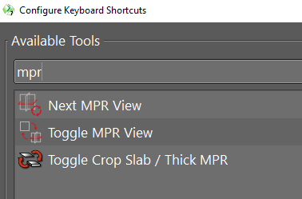
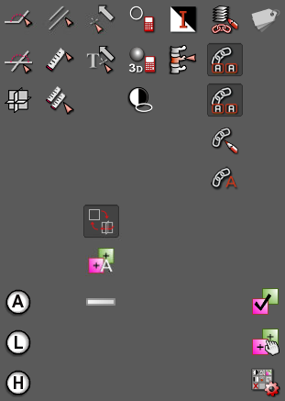
Step 1: Change viewer to MPR
Even better:
Use a keyboard shortcut (Toggle MPR View)
And/or add to tool pallet

Slide 5
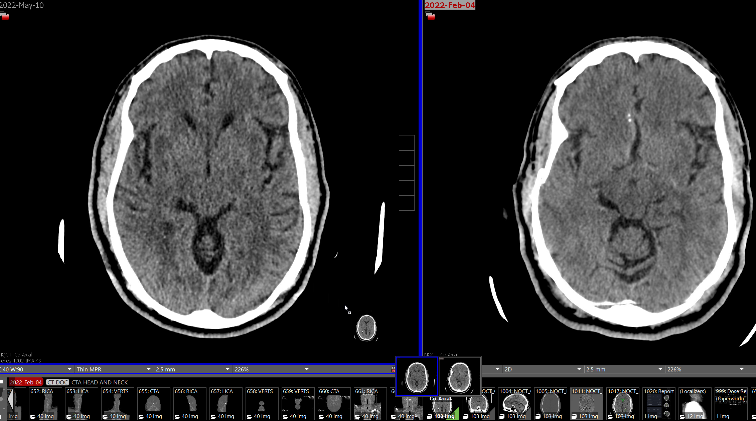
Step 2: Drag comparison CT head onto current CT head using RIGHT click

Slide 6
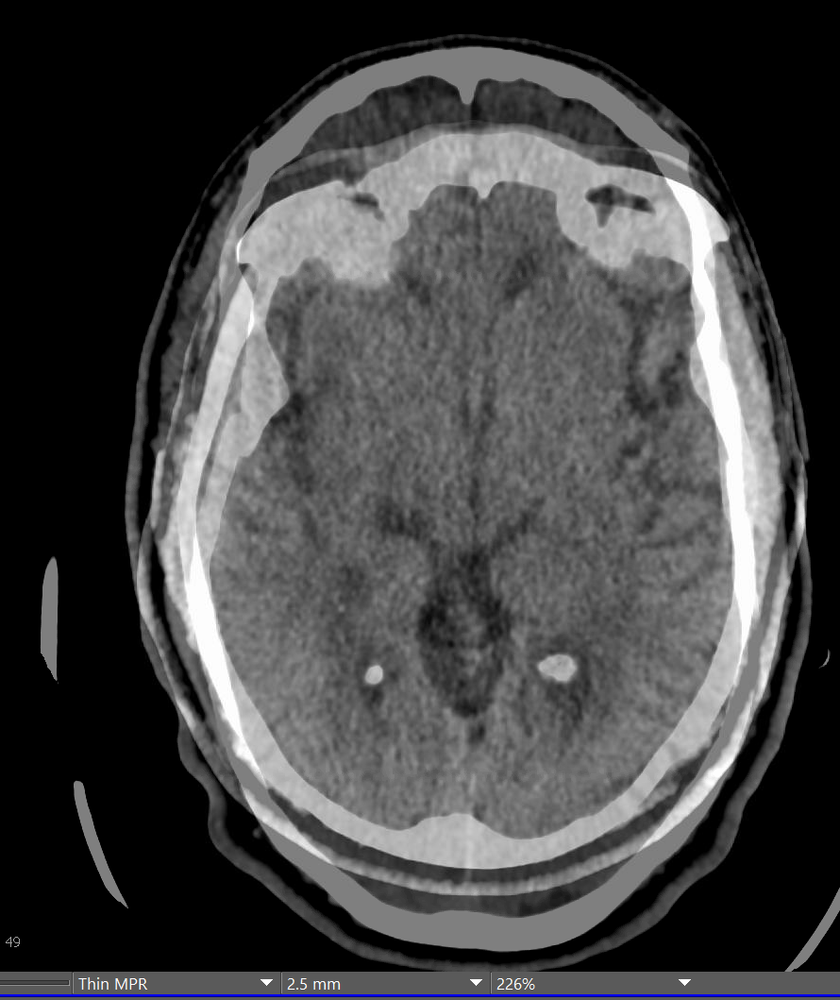
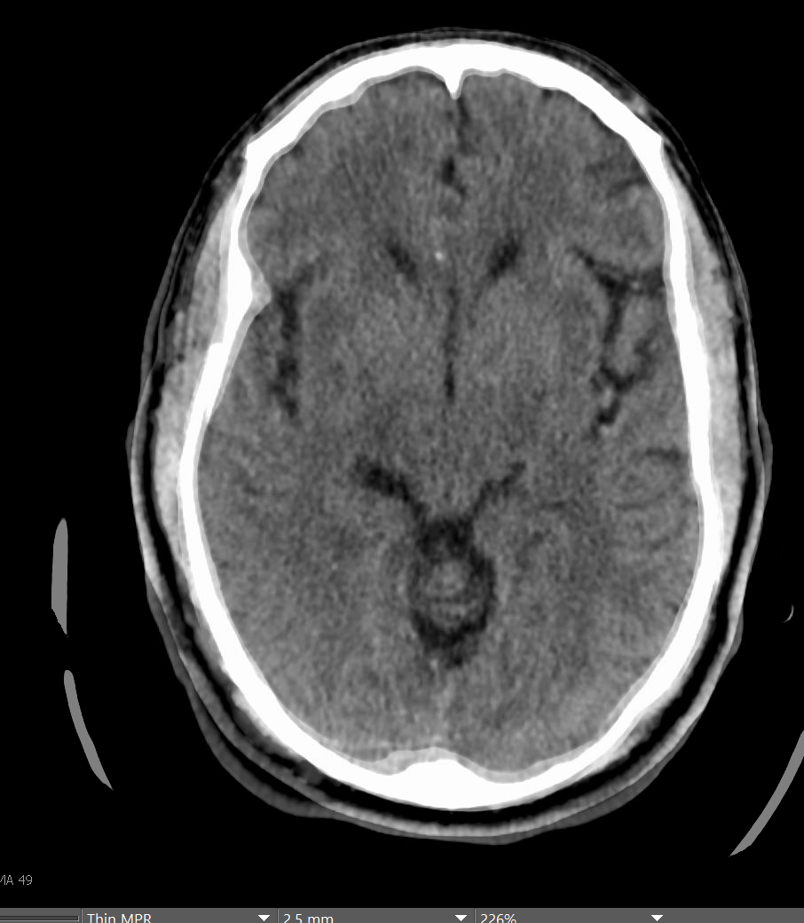
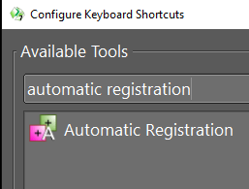
Step 3: Use “Automatic Registration” to line up studies

Slide 7
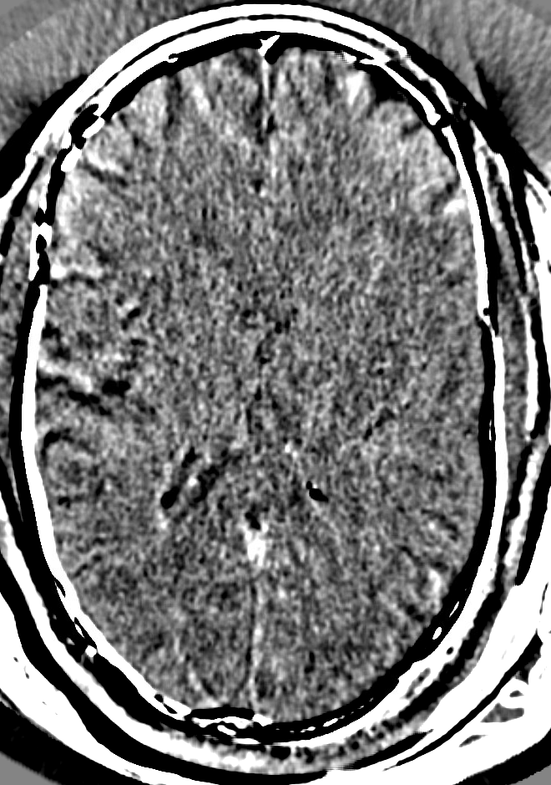
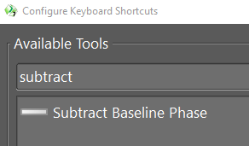
Step 4: Use “Subtract Baseline Phase” tool, then window appropriately. You’re done!

Slide 8
Thanks to Dr. Guo for the inspiration
Many other use cases for subtractions…
Looking for mets on MRI brain by subtracting non-con from contrast+
Superimposing FLAIR on ASL
Looking for new MS lesions

